Slide 1




PROJECT REPORT
Cybersecurity Analysis: Suspicious Web Threat Interactions
A structured data analytics project identifying high-risk traffic patterns using SQL and AWS CloudWatch logs.
AUTHOR
TOOLING
Pratik Sagar|Data Analytics Intern
MySQL Workbench & SQL
DATA SOURCE
AWS CloudWatch Logs

Slide 2





PROJECT OVERVIEW
Executive Summary
Cybersecurity Analysis Report
Context
Project Scope
With the rapid growth of cloud-based applications, cybersecurity threats have become more frequent and complex. Organizations now rely heavily on real-time traffic monitoring systems.
Focuses on analyzing web traffic logs collected via AWS CloudWatch to identify suspicious web interactions using SQL-based data analytics techniques rather than machine learning models.
Analytical Approach
Key Outcomes
Emphasizes structured query analysis, exploratory data analysis (EDA), and logical reasoning using MySQL Workbench. Includes rigorous data cleaning and feature engineering.
Successfully identified high-risk traffic behaviors, geographic hotspots, and port usage trends. Delivered transparent and explainable insights valuable for security teams and decision-makers.
SLIDE 02

Slide 3






STRATEGIC GOALS
Project Objectives
Key Focus Areas
Pattern Recognition
Anomaly Detection
Traffic Segmentation
To understand patterns in web traffic data and establish baseline metrics for normal operations.
To identify indicators of suspicious or abnormal behavior that deviate from established traffic baselines.
To analyze traffic based on critical dimensions including geography, destination ports, and session duration.
SQL-Based Engineering
Actionable Intelligence
To perform rigorous data cleaning and exploratory data analysis (EDA) using structured SQL queries to ensure data integrity.
To derive meaningful, explainable cybersecurity insights from structured data that support decision-making processes.
SLIDE 03

Slide 4





DATA OVERVIEW
TOTAL RECORDS
DATA QUALITY
Dataset Description
282
Clean / No Missing
Key Attributes Schema
table: web_traffic_logs
Source
The dataset consists of web traffic records captured from a production web server and monitored using AWS CloudWatch.
COLUMN NAME
DESCRIPTION
bytes_in
Amount of data received by the server (incoming traffic)
bytes_out
Amount of data sent from the server (outgoing response)
Live Production Environment Log
creation_time
Start timestamp of the web session
end_time
End timestamp of the web session
Focus
src_ip
Source IP address of the request origin
Each record represents a single web interaction session that was flagged or observed during traffic monitoring. The dataset is structured specifically for cybersecurity analysis.
src_ip_country_code
Two-letter country code of the origin
protocol
Network protocol used (e.g., TCP, UDP)
dst_port
Destination port number (e.g., 80, 443)
detection_types
Type of security detection triggered (e.g., WAF rules)
SLIDE 04

Slide 5










METHODOLOGY
Tools & Process Framework
MySQL Workbench
SQL (Structured Query Language)
AWS CloudWatch
Primary Analysis Environment
Core Analytical Language
Data Source Origin
Database Mgmt & Querying
Data Manipulation & EDA
Web Traffic Logging
Analysis Workflow
1
2
3
4
5
6
7
EDA
DB Setup
Import
Cleaning
Engineering
Query volume, geography, ports & detections
Deep Dive
Insights
Create dedicated database schema in MySQL Workbench
Load dataset via Import Wizard ensuring correct types
Remove duplicates & standardize formats
Calculate 'session_duration' from timestamps
Analyze high-risk & long session anomalies
Summarize findings for stakeholders
SLIDE 05

Slide 6




DATA QUALITY & ENGINEERING
Data Cleaning & Preparation
Cybersecurity Analysis Report
Duplicate
Data
Feature
Removal
Standardization
Engineering
Duplicate records were rigorously identified and removed from the dataset. This critical step prevents skewed analysis results and ensures that traffic volume metrics accurately reflect unique interaction sessions rather than redundant log entries.
Inconsistent data formats were normalized across the dataset. Country codes were converted to uppercase for consistent grouping, and timestamp fields were formatted into proper SQL datetime objects to enable precise time-series analysis.
A new metric, session_duration, was derived by calculating the time difference between session start and end times. This feature is instrumental in detecting persistent connections that deviate from normal user browsing behavior.
Ensures analytical accuracy
Unified format for grouping
Identifies suspicious longevity
SLIDE 06

Slide 7


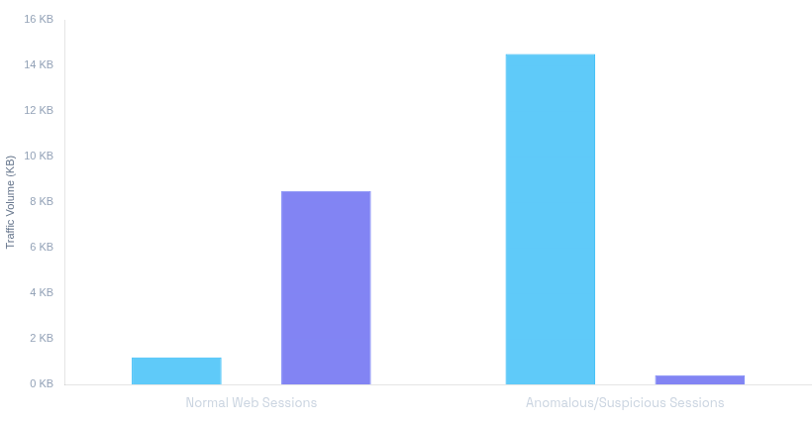


EXPLORATORY DATA ANALYSIS
Traffic Volume Analysis
SELECT AVG(bytes_in), AVG(bytes_out)...
Inbound vs. Outbound Traffic Volume
Bytes In (Request)
Bytes Out (Response)
KEY OBSERVATION
Asymmetric Traffic
Identified sessions with unusually high Incoming Traffic (payloads) but minimal Outgoing Responses.
Indicates potential probing, fuzzing, or reconnaissance attempts where the server rejects the request.
AVG SUSPICIOUS PAYLOAD
14.2 KB
450% vs Normal
AVG RESPONSE SIZE
0.4 KB
Primarily Error Codes
SLIDE 07

Slide 8


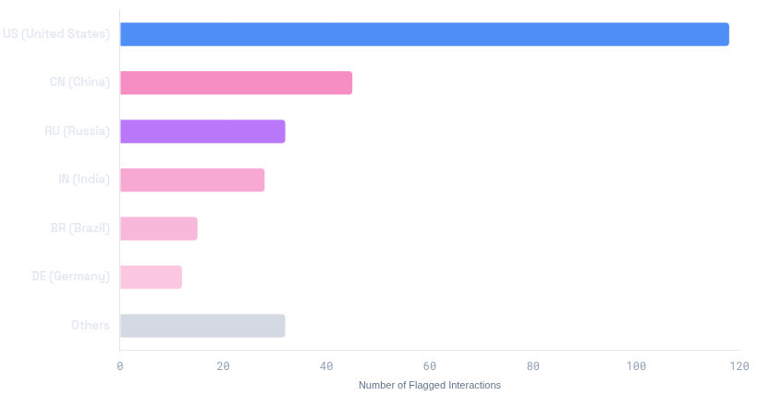


EXPLORATORY DATA ANALYSIS
Country-wise Traffic Distribution
SELECT src_ip_country_code, COUNT(*) FROM traffic_logs GROUP BY...
KEY INSIGHT
Suspicious Interaction Counts by Origin
Flagged Sessions
Targeted Origins
A small number of countries account for a disproportionately large share of flagged interactions.
Suggests automated botnets or coordinated attacks from specific regions.
TOP SOURCE (US)
42%
of all traffic
TOP 3 COUNTRIES
68%
Combined
High Concentration
SLIDE 08

Slide 9


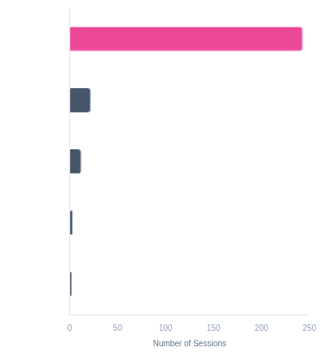


EXPLORATORY DATA ANALYSIS
Port Usage Analysis
SELECT dst_port, COUNT(*) FROM logs GROUP BY dst_port...
KEY FINDING
Destination Port Distribution
HTTPS (443)
Other Ports
Encrypted Threats
The majority of interactions occur over Port 443 (HTTPS), indicating malicious traffic is hiding within encrypted tunnels.
Makes traditional payload inspection difficult without SSL decryption.
HTTPS TRAFFIC SHARE
86.2%
Dominant Protocol
UNIQUE PORTS TARGET
4
Focused vectors (80, 8080)
SLIDE 09

Slide 10


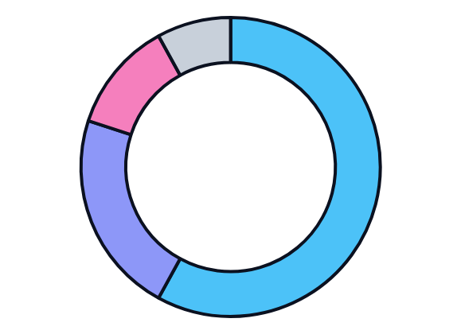

DETECTION ANALYSIS
Detection Type Distribution
SELECT detection_type, COUNT(*) FROM logs...
CORE INSIGHT
Breakdown of Triggered Security Rules
WAF Dominance
A significant majority of records were intercepted by AWS WAF Rules.
GENERIC RULES
58%
WAF Rule Set
confirms the dataset is composed of suspicious activity.
282
HIGH RISK
22%
SQL Injection Pattern
TOTAL EVENTS
CLIENT SIDE
12%
PRIMARY THREAT
XSS Attempt
SQL Injection
High Severity Pattern
UNCATEGORIZED
8%
Other / Unknown
BLOCK RATE
100%
Automated Prevention
SLIDE 10

Slide 11



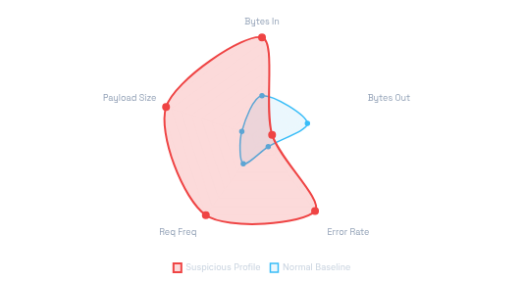
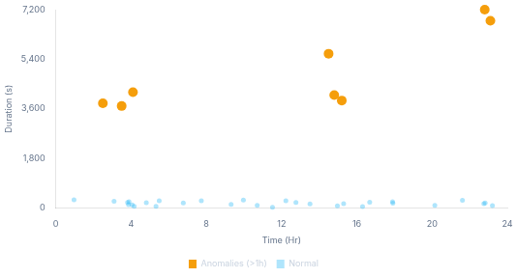
DEEP DIVE ANALYSIS
Advanced Analysis Results
2 CRITICAL PATTERNS DETECTED
High-Risk Traffic
CRITICAL RISK
Long Session Detection
SUSPICIOUS
Payload Asymmetry (Bytes In vs. Out)
Temporal Anomaly Analysis
SELECT
bytes_in >
src_ip, bytes_in, bytes_out
FROM
traffic_logs
WHERE
SELECT
(end_time, creation_time)
src_ip,
TIMEDIFF
PERCENTILE
(95)
AND
bytes_out <
PERCENTILE
(10);
AS
duration
FROM
traffic_logs
HAVING
duration >
3600
;
-- 1 Hour Threshold
INTERPRETATION
FLAGGED IPS
INTERPRETATION
FLAGGED SESSIONS
Large inbound payloads with negligible responses indicate blind SQL injection or fuzzing attempts.
14
Sessions > 1 hour suggest data scraping, C2 beacons, or slow-loris attacks.
8
SLIDE 11

Slide 12







PROJECT OUTCOMES
Key Findings & Insights
5 Core Discoveries
01
02
03
Non-Random Patterns
Geographic Hotspots
HTTPS ≠ Safety
Suspicious web traffic is highly structured and pattern-based, rather than random noise. Attackers use automated scripts that leave distinct digital footprints in log data.
A small number of specific geographic regions repeatedly appear in threat logs. This concentration suggests targeted campaigns or centralized botnet infrastructure.
The majority of malicious interactions occurred over port 443 (HTTPS). Encryption is frequently leveraged by attackers to conceal payloads and evade basic inspection.
04
05
Behavioral Indicators
SQL Efficacy
Session metadata is a stronger risk indicator than IP reputation alone. Two distinct high-risk behaviors were identified:
Structured query analysis proved sufficient to extract meaningful cybersecurity insights without complex machine learning models. Logical rules and aggregations effectively surfaced anomalies in the raw operational data.
Asymmetric Volume: High inbound bytes vs. zero/low outbound.
Abnormal Duration: Extremely long sessions indicating scraping.
SLIDE 12

Slide 13












PROJECT CONCLUSION
Conclusions & Business Value
Project Summary
Demonstrated Capabilities
This project demonstrates how structured SQL analysis can effectively replace complex ML models for initial threat detection. By focusing on data cleaning, exploratory analysis, and logical reasoning, we transformed raw AWS CloudWatch logs into actionable security intelligence.
DATA ANALYTICS INTERN
Advanced SQL Proficiency
Complex joins, aggregations, window functions, and data cleaning.
Business Value Delivered
Analytical Thinking
Translating raw operational data into meaningful business insights.
Cost-Effective Detection
Auditability
Domain Application
Utilizes existing database infrastructure without requiring expensive third-party security tools or high-compute ML resources.
SQL-based logic provides fully transparent and explainable findings, crucial for compliance and security auditing.
Applying data skills to real-world cybersecurity challenges.
Technical Communication
Presenting technical findings clearly to stakeholders.
Actionable Intelligence
Reproducibility
Highlights specific geographic hotspots and port behaviors, allowing teams to prioritize monitoring resources effectively.
Structured workflow allows for automated daily reporting and consistent threat tracking over time.
Ready for Next Steps
SLIDE 13

Slide 14

Thank You
SESSION COMPLETED
2026 CYBERSECURITY PROJECT REPORT

